Slide 1
Adding Stationing in ArcGIS Lines
Sulochan Dhungel
5/28/2020

Slide 2
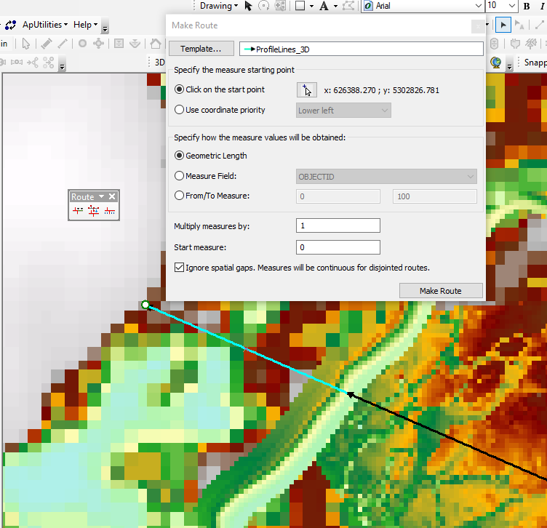
Activate “Routing Editing” toolbar
Convert lines to a feature class in a geodatabase.
Start Editing
Press Create Route
Select the line which you want to station
Change the start point based on where you want to start stationing

Slide 3
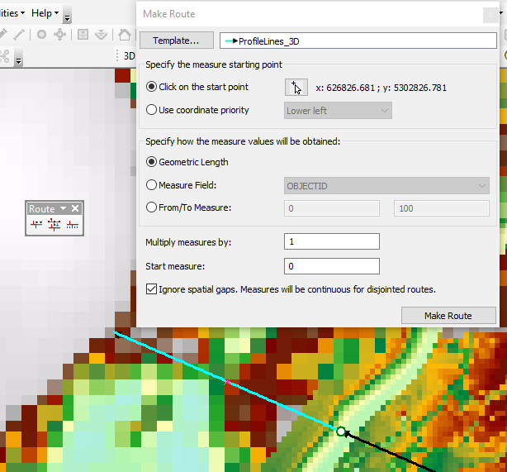
Activate “Routing Editing” toolbar
Convert lines to a feature class in a geodatabase.
Start Editing
Press Create Route
Select the line which you want to station
Change the start point based on where you want to start stationing
Click Make Route

Slide 4
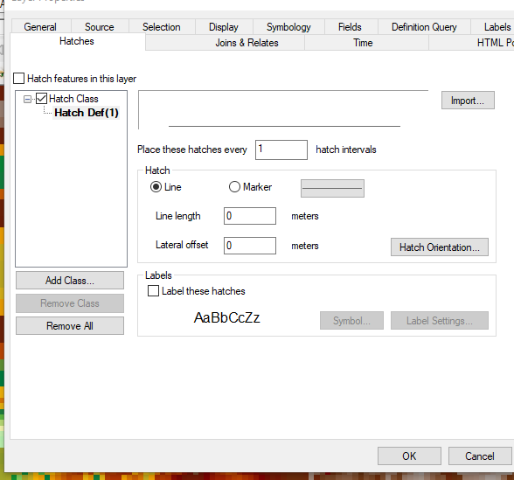

Slide 5
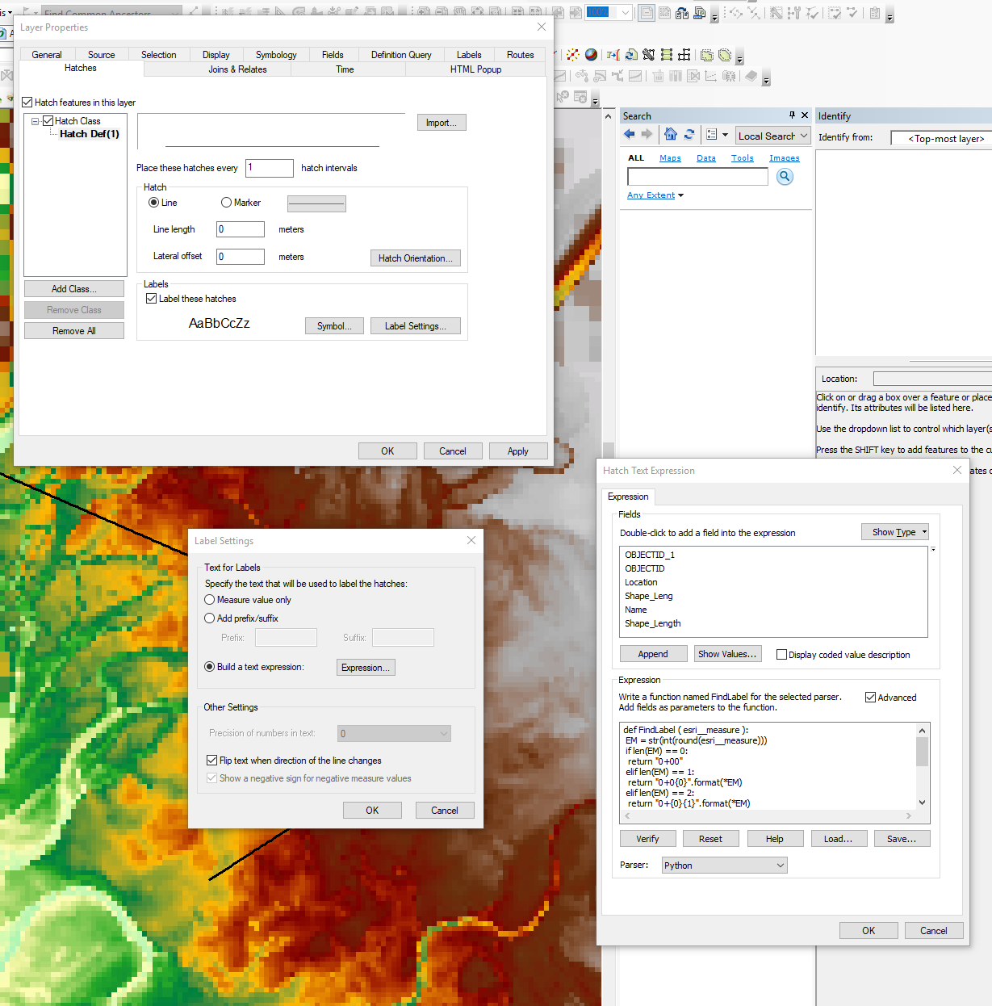

Slide 6
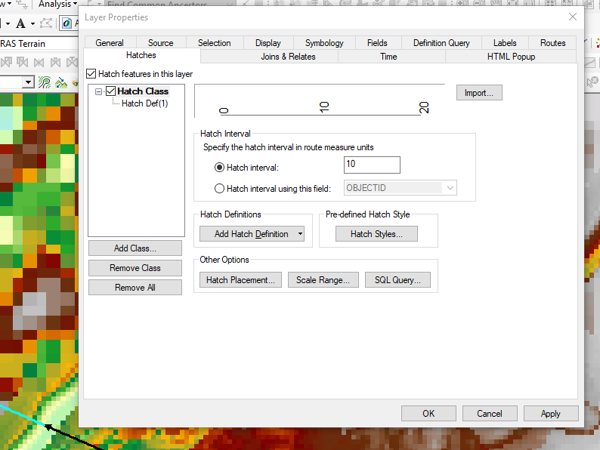

Slide 7
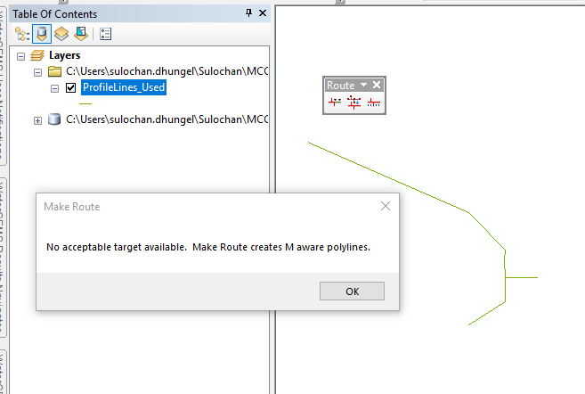
Issue 1
No acceptable target available.

Slide 8
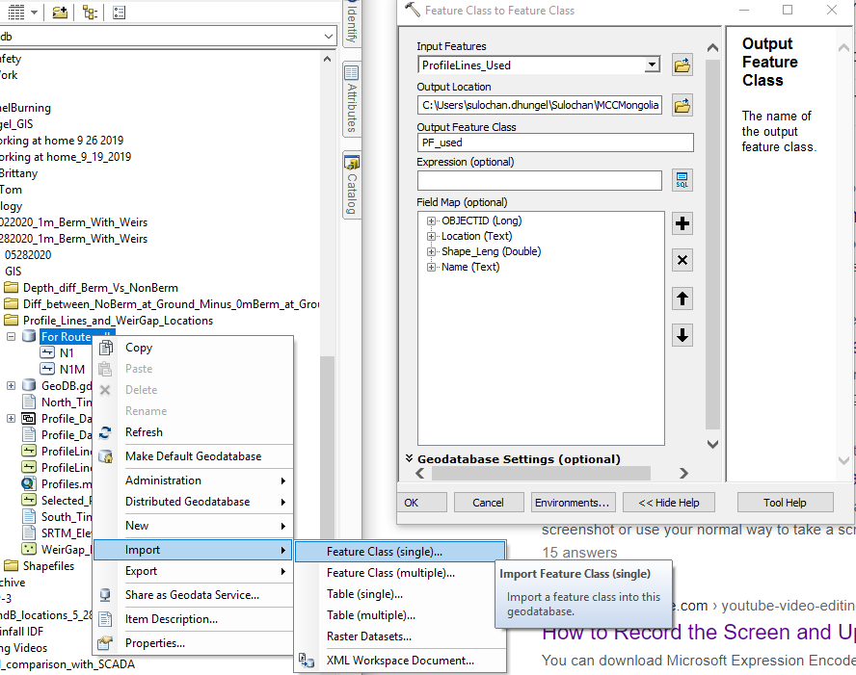
Issue
No acceptable target available.
Probable solution:
Try to create feature class out of the line shapefile by creating a file geodatabase and importing this line shapefile into it.

Slide 9
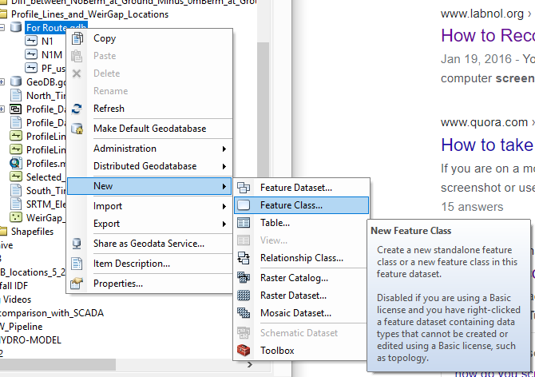
Issue
No acceptable target available.
Probable solution:
Try to create feature class out of the line shapefile by creating a file geodatabase and importing this line shapefile into it.
If this still results in the same error, create a new polyline feature class with M and Z values and copy all from original line to this feature class.

Slide 10
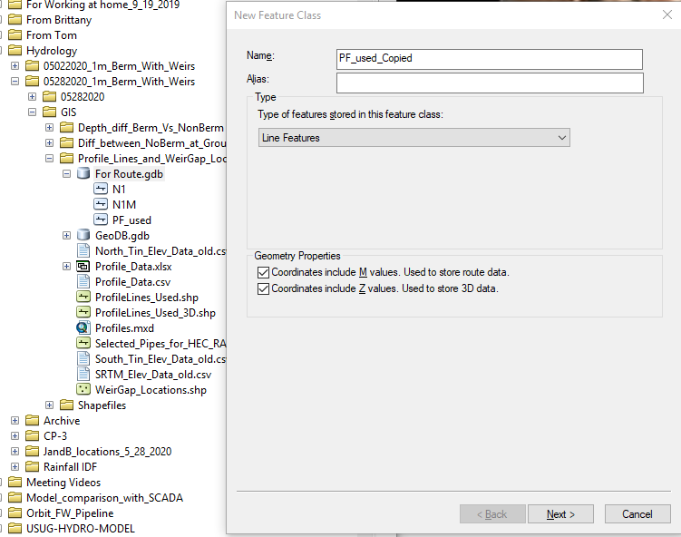
Issue
No acceptable target available.
Probable solution:
Try to create feature class out of the line shapefile by creating a file geodatabase and importing this line shapefile into it.
If this still results in the same error, create a new polyline feature class with M and Z values and copy all from original line to this feature class.
Everything else can be set to default or changed acc to need after pressing “Next>”.

Slide 11
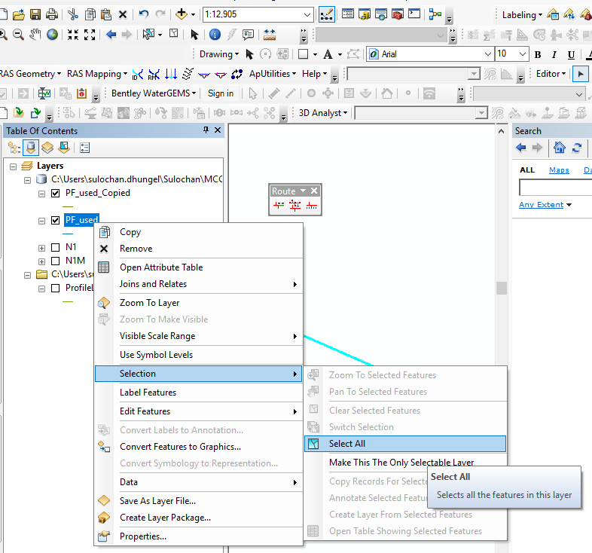
Issue
No acceptable target available.
Probable solution:
Try to create feature class out of the line shapefile by creating a file geodatabase and importing this line shapefile into it.
If this still results in the same error, create a new polyline feature class with M and Z values and copy all from original line to this feature class.
Copy and paste to this new layer with M ‘activated’.
Edit

Slide 12
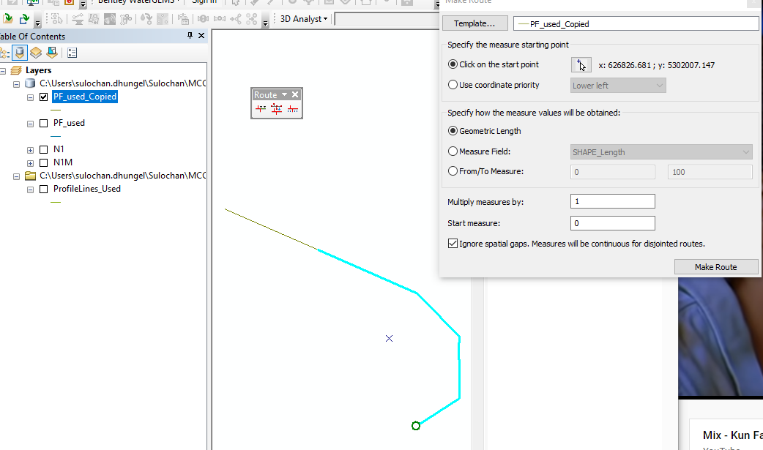
Issue
No acceptable target available.
Probable solution:
Try to create feature class out of the line shapefile by creating a file geodatabase and importing this line shapefile into it.
If this still results in the same error, create a new polyline feature class with M and Z values and copy all from original line to this feature class.
It WORKED!

